Slide 1

Title:
Name:

Slide 2

VISION
To become a university of international repute
MISSION
To make meaningful contributions to the creation of prosperity and development of the nation and the well-being of all human beings through the exploration and dissemination of knowledge
EDUCATIONAL GOAL
Produce superior graduates who are holistic, ihsan,
patriotic and resilient
VALUES
Ihsan, Diversity, Sustainability
NICHE AREA
Agriculture

Slide 3
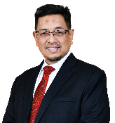
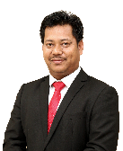
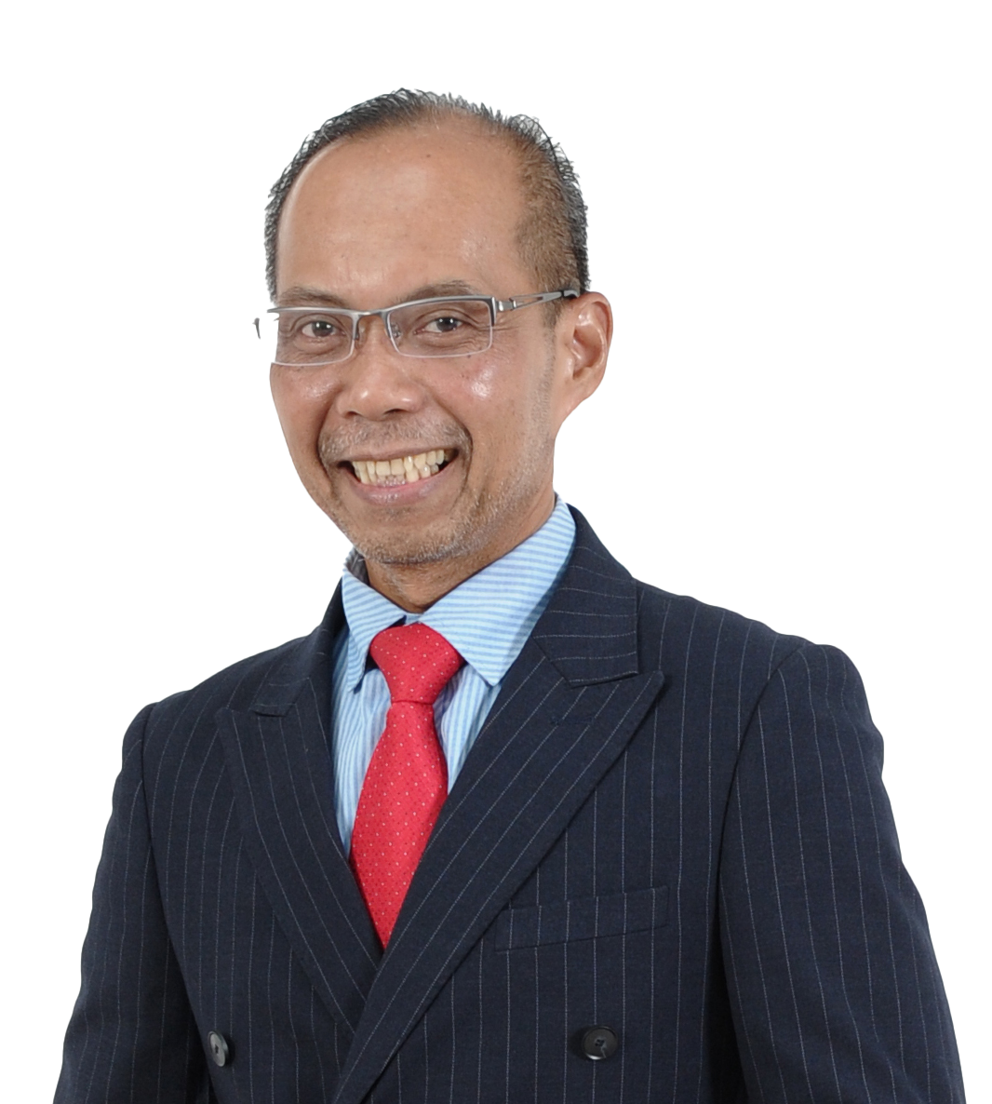
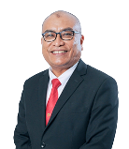
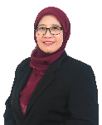
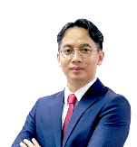

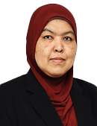
UNIVERSITY MANAGEMENT
Dato' Prof. Ir. Dr.
Ahmad Farhan Mohd Sadullah FASc
Vice Chancellor
Prof. Ir. Dr. Abd. Rahim Abu Talib Deputy Vice Chancellor
(Academic & International)
Prof. Dr. Zamberi Sekawi
Deputy Vice Chancellor
(Research & Innovation)
Prof. Dr. Arifin Abdu
Deputy Vice Chancellor
(Student Affairs & Alumni)
Prof. Dr. Shamsul Bahri
Hj. Md Tamrin
Deputy Vice Chancellor
(Industry & Community Relations)
Mr. Muhazam
Mansor
Registrar
Mdm. Siti Amira Shukor
Bursar
Ms. Haslina Abu Seman@Talib
Chief Librarian
Mr. Muhammad Adil
Ahmad Tajuddin
Legal Advisor
Assoc. Prof. Dr.
Dahlia Zawawi
Director
Centre for Corporate Strategy & Relations
Prof. Dr.
Shahrul Razid Sarbini
Director
UPM Sarawak
Ir. Dr. Maznah Sarhan
Director
Development Office &
Asset Management
Information | as of April 2026

Slide 4

7,700+ Staff
Student Mobility
Programmes
1,800+
3,400+
Serdang
Academic Staff
Inbound Students
3000 Hectares
5,900+
1,800+
Located within 30 mins to Kuala Lumpur, Putrajaya & KLIA
Non – academic staff
Outbound Students
Sarawak
as of January 2026
as of 31st December 2025
714.2 Hectares
30,700+
Approximately 30,700+ student population comprises
both local and international students from more
than 75 countries around the world
84 Responsibility
Centres
UPM Sarawak is situated 13 km from the town of Bintulu and is surrounded by lush green forest rich with many different types of flora and fauna.
15 Faculties
22 Centres
11 Institutes
10 Residential Colleges
10 Offices
8 Divisions
5 Services
1 Academy
2 Schools
18,600+
Undergraduate students
as of December 2025
12,100+
Postgraduate Students
as of December 2025

Slide 5
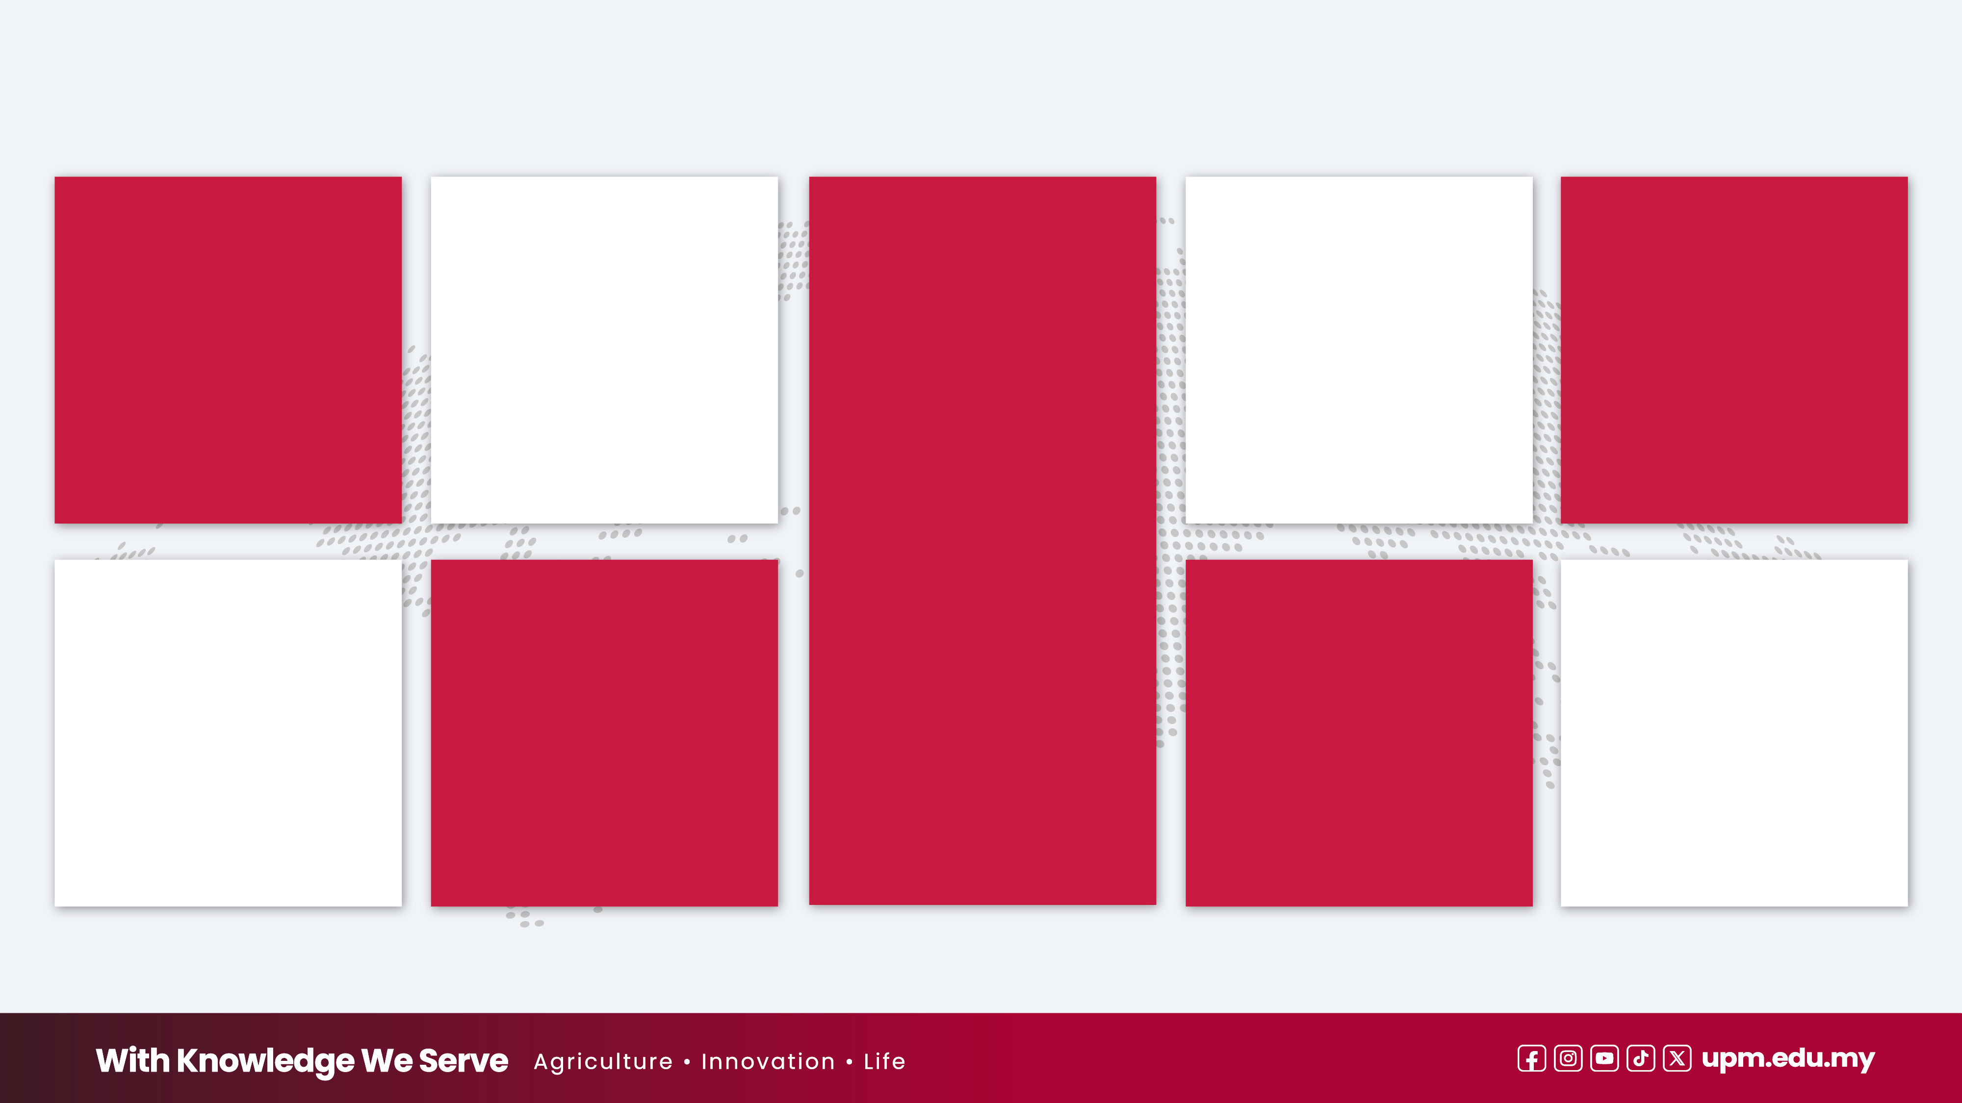



INTERNATIONAL RANKING
138
22
329
31
th
nd
20 Subjects
th
st
TOP 200
2027
Asia 2026
By subject
2026
Sustainability 2026
38
th
in the world
55
81
Veterinary Science
123
th
st
301-400
rd
64
64
#
th
in the world
Agriculture & Forestry
1
st
2026
in Malaysia
2026
Information | as of June 2026

Slide 6

FACULTIES, INSTITUTES & SCHOOLS
Institutes
Institute of Nanoscience and Nanotechnology (ION2)
Malaysian Research Institute on Ageing (MyAgeing®)
Institute for Mathematical Research (INSPEM)
Halal Products Research Institute (IPPH)
Institute for Social Science Studies (IPSAS)
Institute of Plantation Studies (IKP)
International Institute of Aquaculture and Aquatic (I-AQUAS)
Institute of Bioscience (IBS)
Institute of Tropical Forestry and Forest Products (INTROP)
Institute of Tropical Agriculture and Food Security (ITAFoS)
Institute of Ecosystem Science Borneo (UPMS)
Faculties
Faculty of Agriculture •
Faculty of Science •
Faculty of Engineering •
  Faculty of Educational Studies •
  Faculty of Food Science and Technology •
Faculty of Forestry and Environment •
Faculty of Veterinary Medicine •
Faculty of Human Ecology •
  Faculty of Modern Languages and Communication •
Faculty of Design and Architecture •
Faculty of Medicine and Health Sciences •
Faculty of Computer Science and Information Technology •
  Faculty of Biotechnology and Biomolecular Sciences •
  Faculty of Agricultural and Forestry Science (UPMS) •
Faculty of Humanities, Management and Science (UPMS) •
11
15
2
Schools
Higher Education Centre
of Excellence (HICoE)
3
  • School of Business and Economics
• School of Graduate Studies
Institute of Bioscience (IBS)•
Institute of Tropical Forestry and Forest Products (INTROP)•
Institute of Tropical Agriculture and Food Security (ITAFoS•
Information | as of January 2026

Slide 7
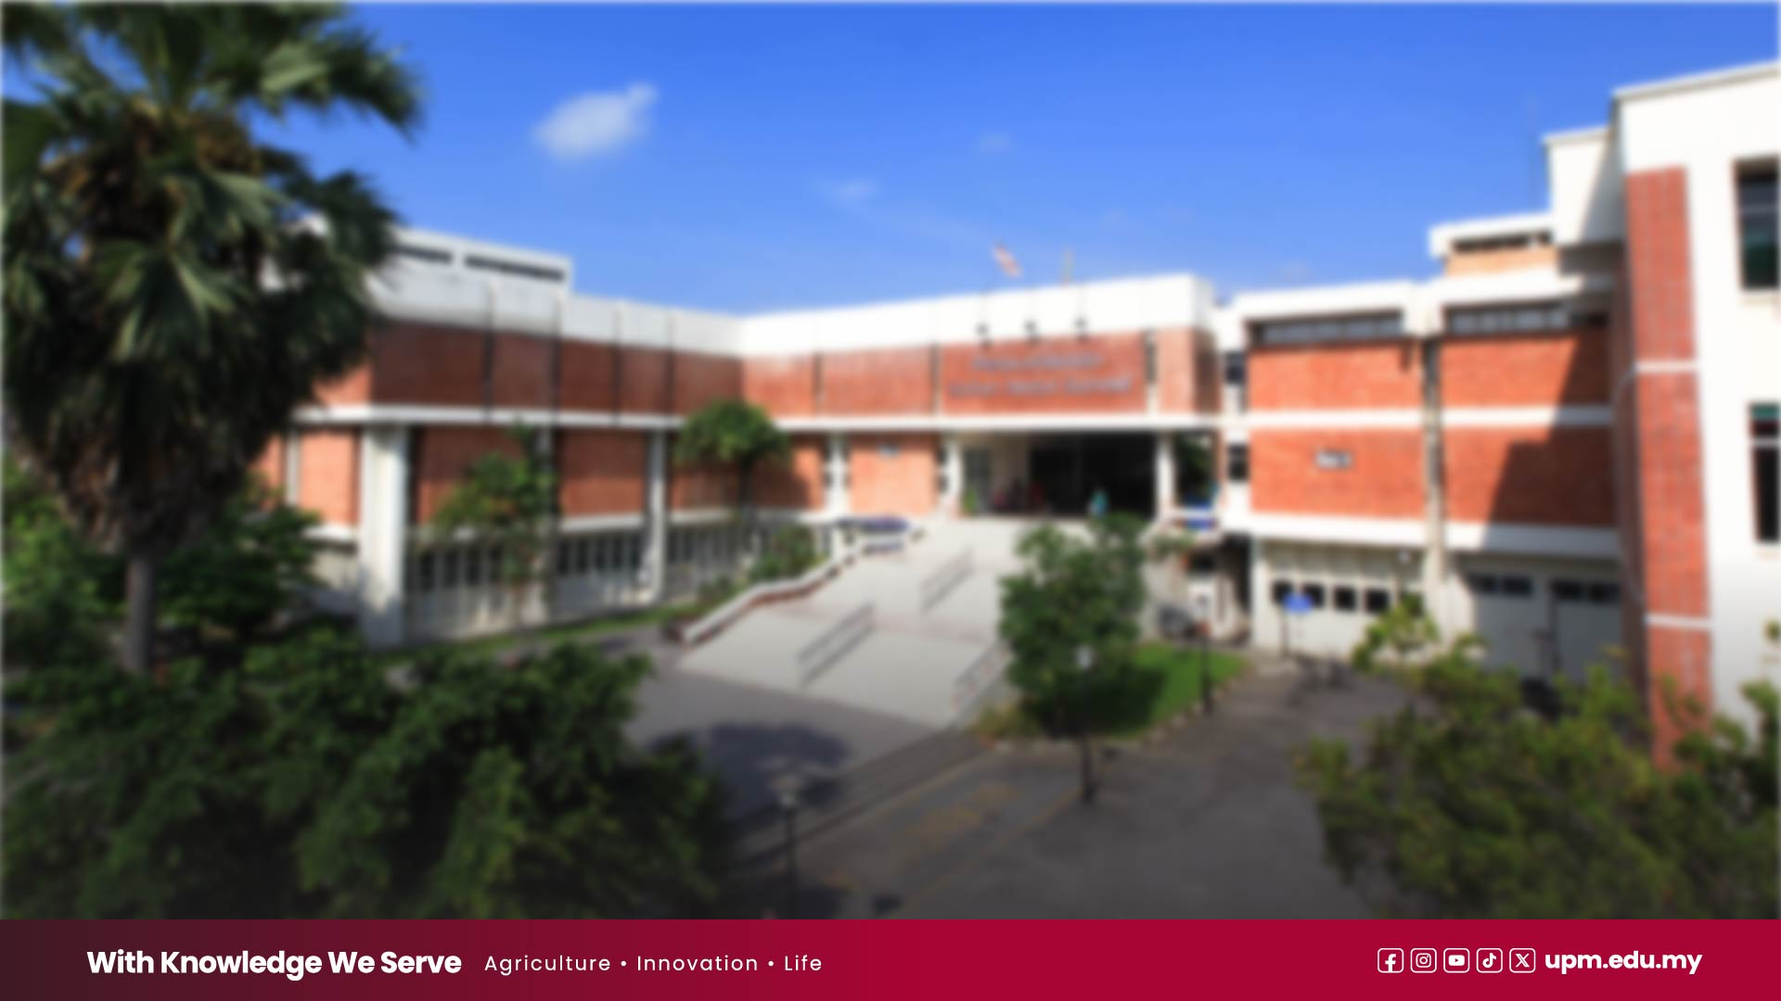





INTERNATIONAL ACCREDITATION:
ACADEMIC PROGRAMMES
Association of MBAs
(AMBA)
AACSB Accredited
(Association to Advance Collegiate Schools of Business)
EQUIS Accredited
(EFMD Quality Improvement System)
International Engineering Alliance (IEA)
Community for Environmental Disciplines in Higher Education (CEDHE),
the education committee of the Institution
of Environmental Sciences (IES)
Indonesian Accreditation Agency for Higher
Education in Health (IAAHEH)
Royal Society of Chemistry
The Institute of Food Technologists (IFT)
Information | as of January 2026

Slide 8









INTERNATIONAL COLLABORATIVE PROGRAMMES (ICP)
UNIVERSITY OF NEWCASTLE,
AUSTRALIA
Programme (s) Joint PhD
15
KYUSHU INSTITUTE OF
TECHNOLOGY, JAPAN
Programme (s) Double Master l
Double PhD
SHARIF UNIVERSITY OF
TECHNOLOGY, IRAN
Programme (s) Joint Master I
Joint PhD
Collaborative Programmes
MAEJO UNIVERSITY,
THAILAND
Programme (s) Dual PhD
IPB UNIVERSITY
Programme (s) Dual Master I
Dual PhD
9
UNIVERSITAS BRAWIJAYA
INDONESIA
Programme (s) Dual Master I
Dual PhD
KASETSART UNIVERSITY,
THAILAND
Programme (s) Dual Master I
Dual PhD
International Institutions
ISLAMIC AZAD UNIVERSITY
OF ISFAHAN, IRAN
Programme (s) Dual Master I
Dual PhD
NATIONAL TAIWAN
UNIVERSITY, TAIWAN
Programme (s) Dual PhD
Information | as of January 2026

Slide 9
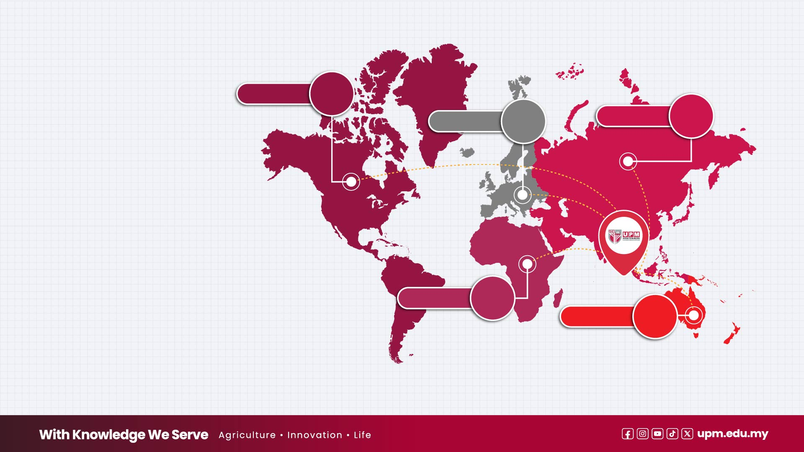
STRATEGIC COLLABORATION
International MoU/MoA
Information | as of July 2026
America
8
216
30
Asia
65
Europe
Numbers of Collaboration by Continent
Total Domestic
and International Collaborations
480
Africa
1
Oceania
6
Domestic MoU/MoA
225
Industries and NGO
32
Government Agencies
11
Universities and Institute
264
Collaborations
Collaborations
Collaborations

Slide 10

Thank you

